Slide 1


Multi-IMU Calibration, Fusion, and Bias Estimation for Improved Odometry
Jongwon Lee
Final Presentation @ Amazon Robotics
August 20th, 2025

Slide 2
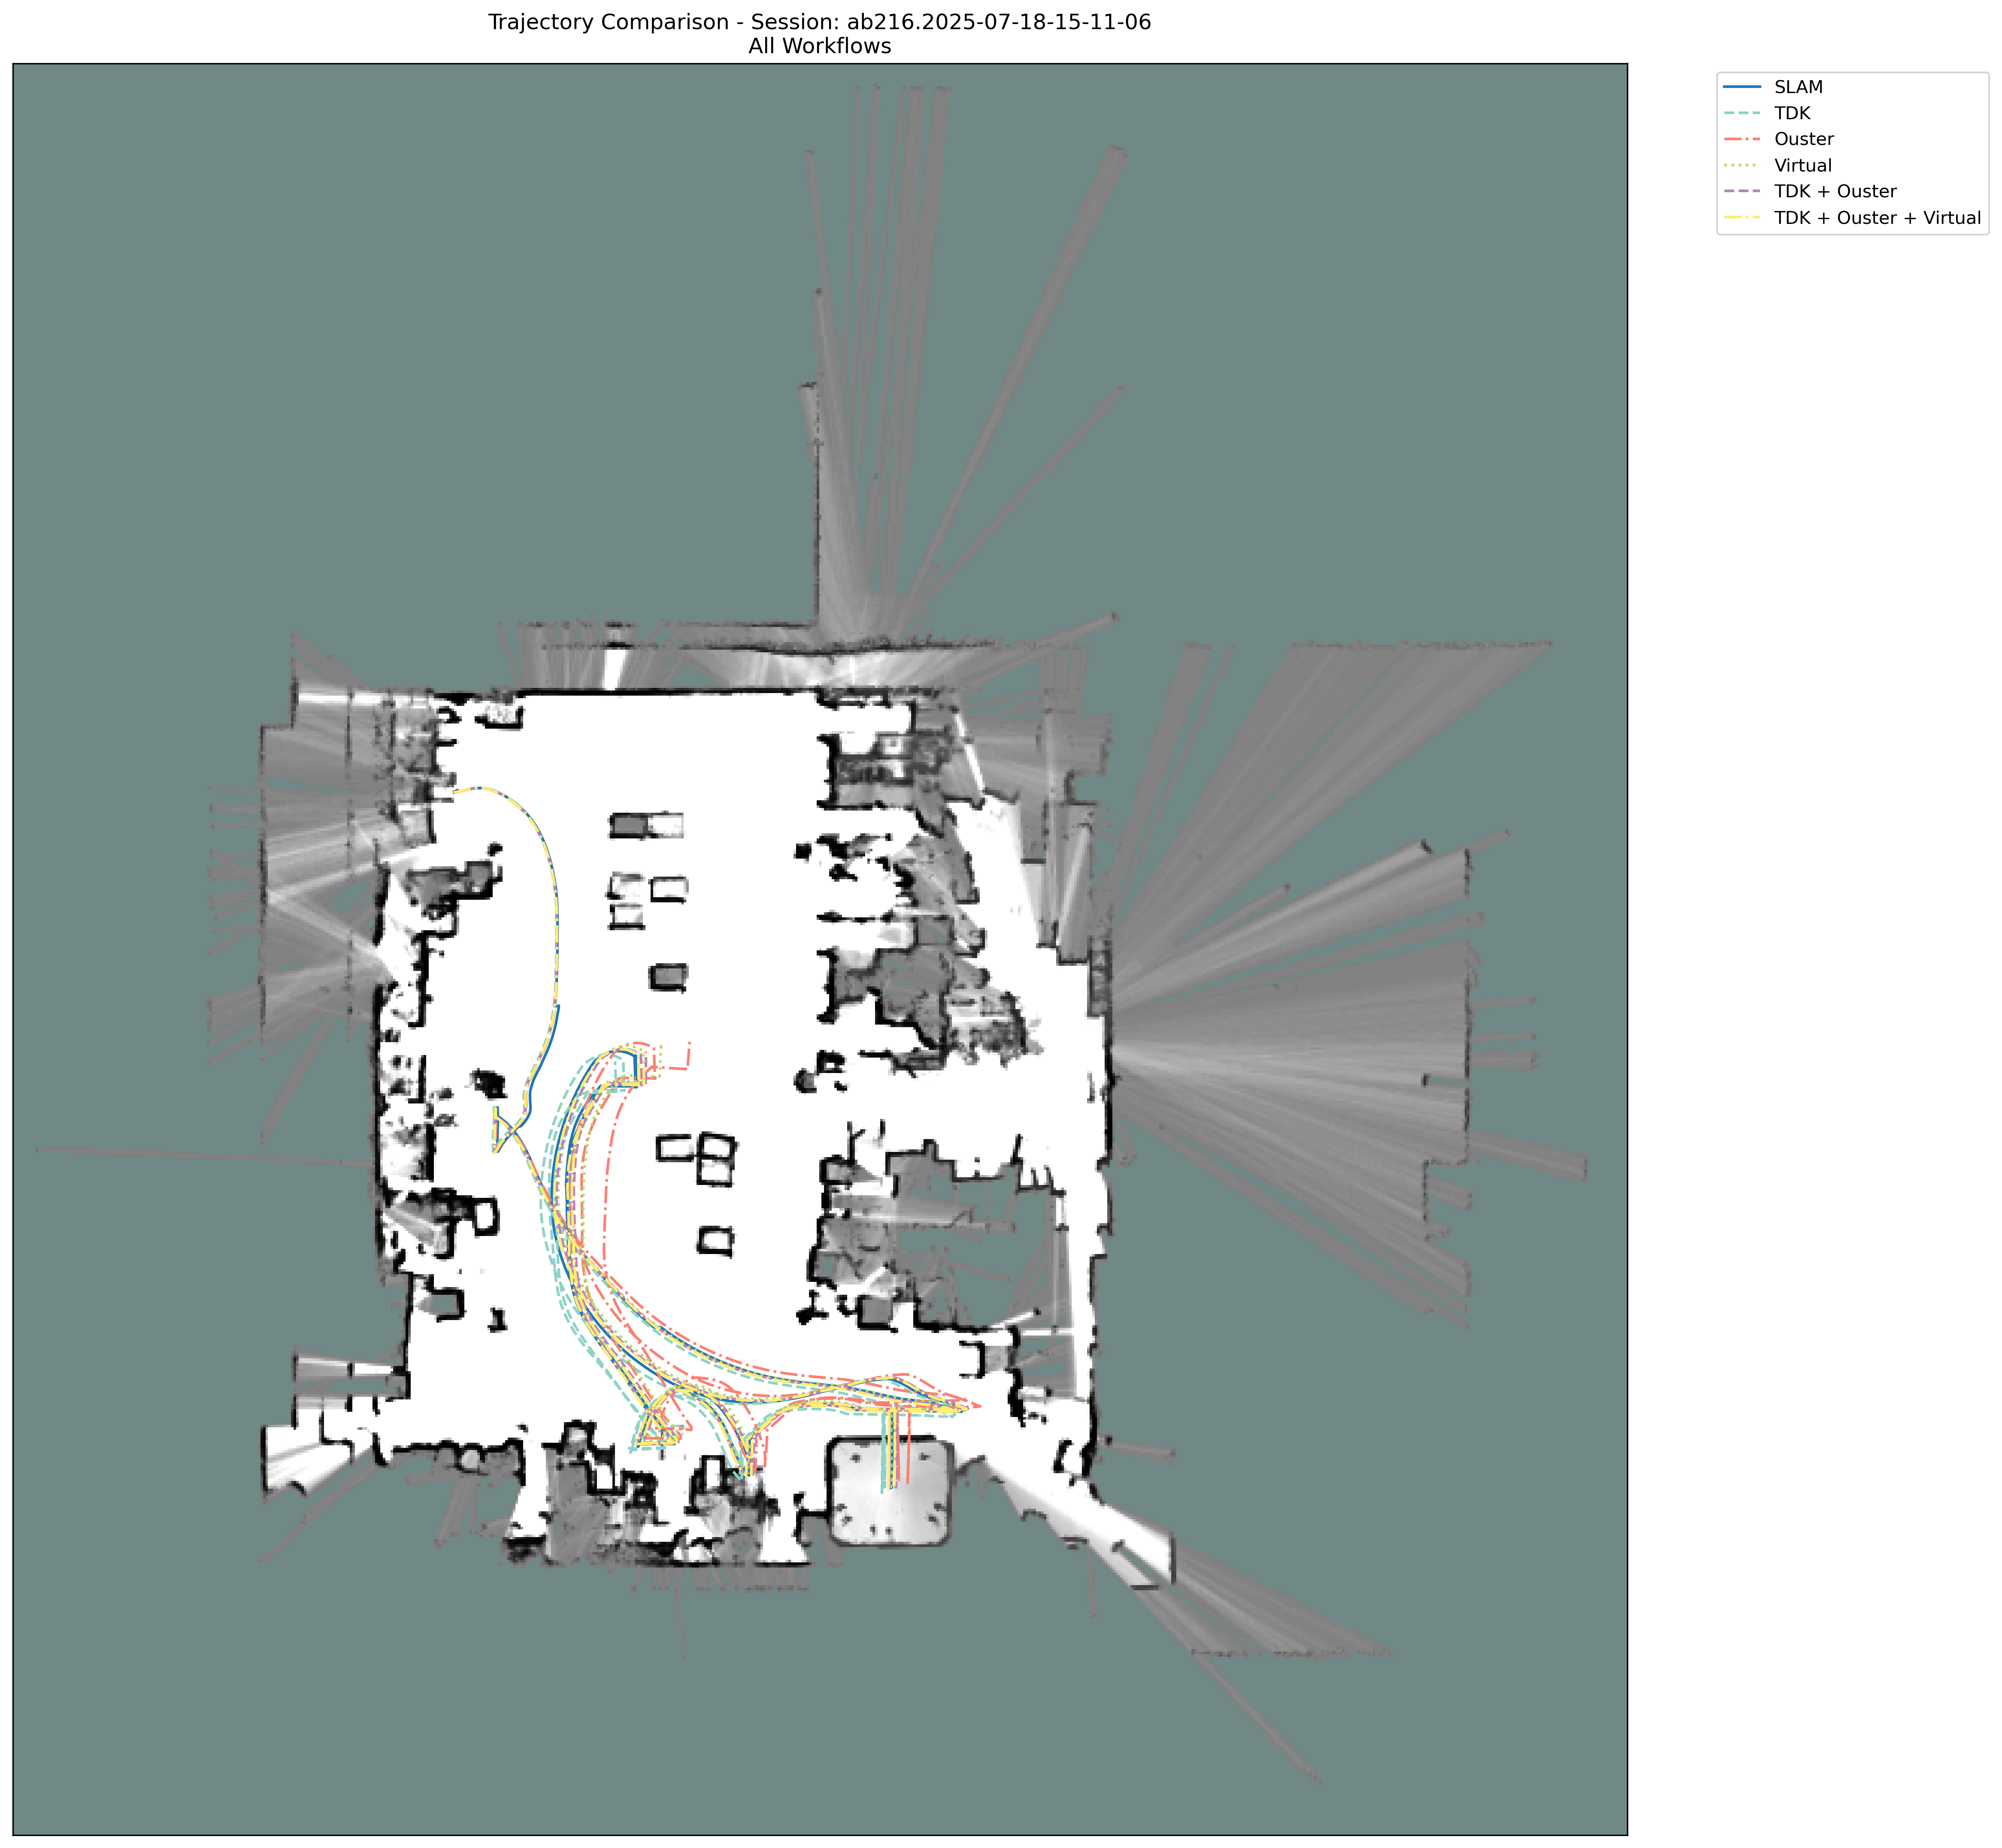
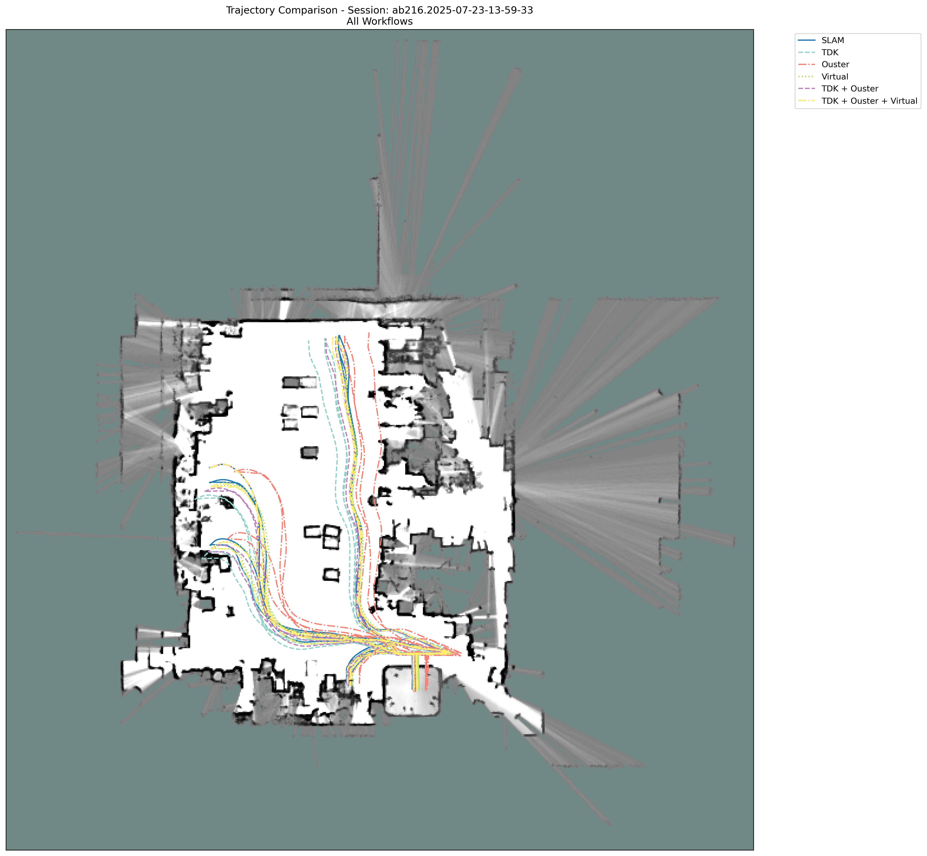
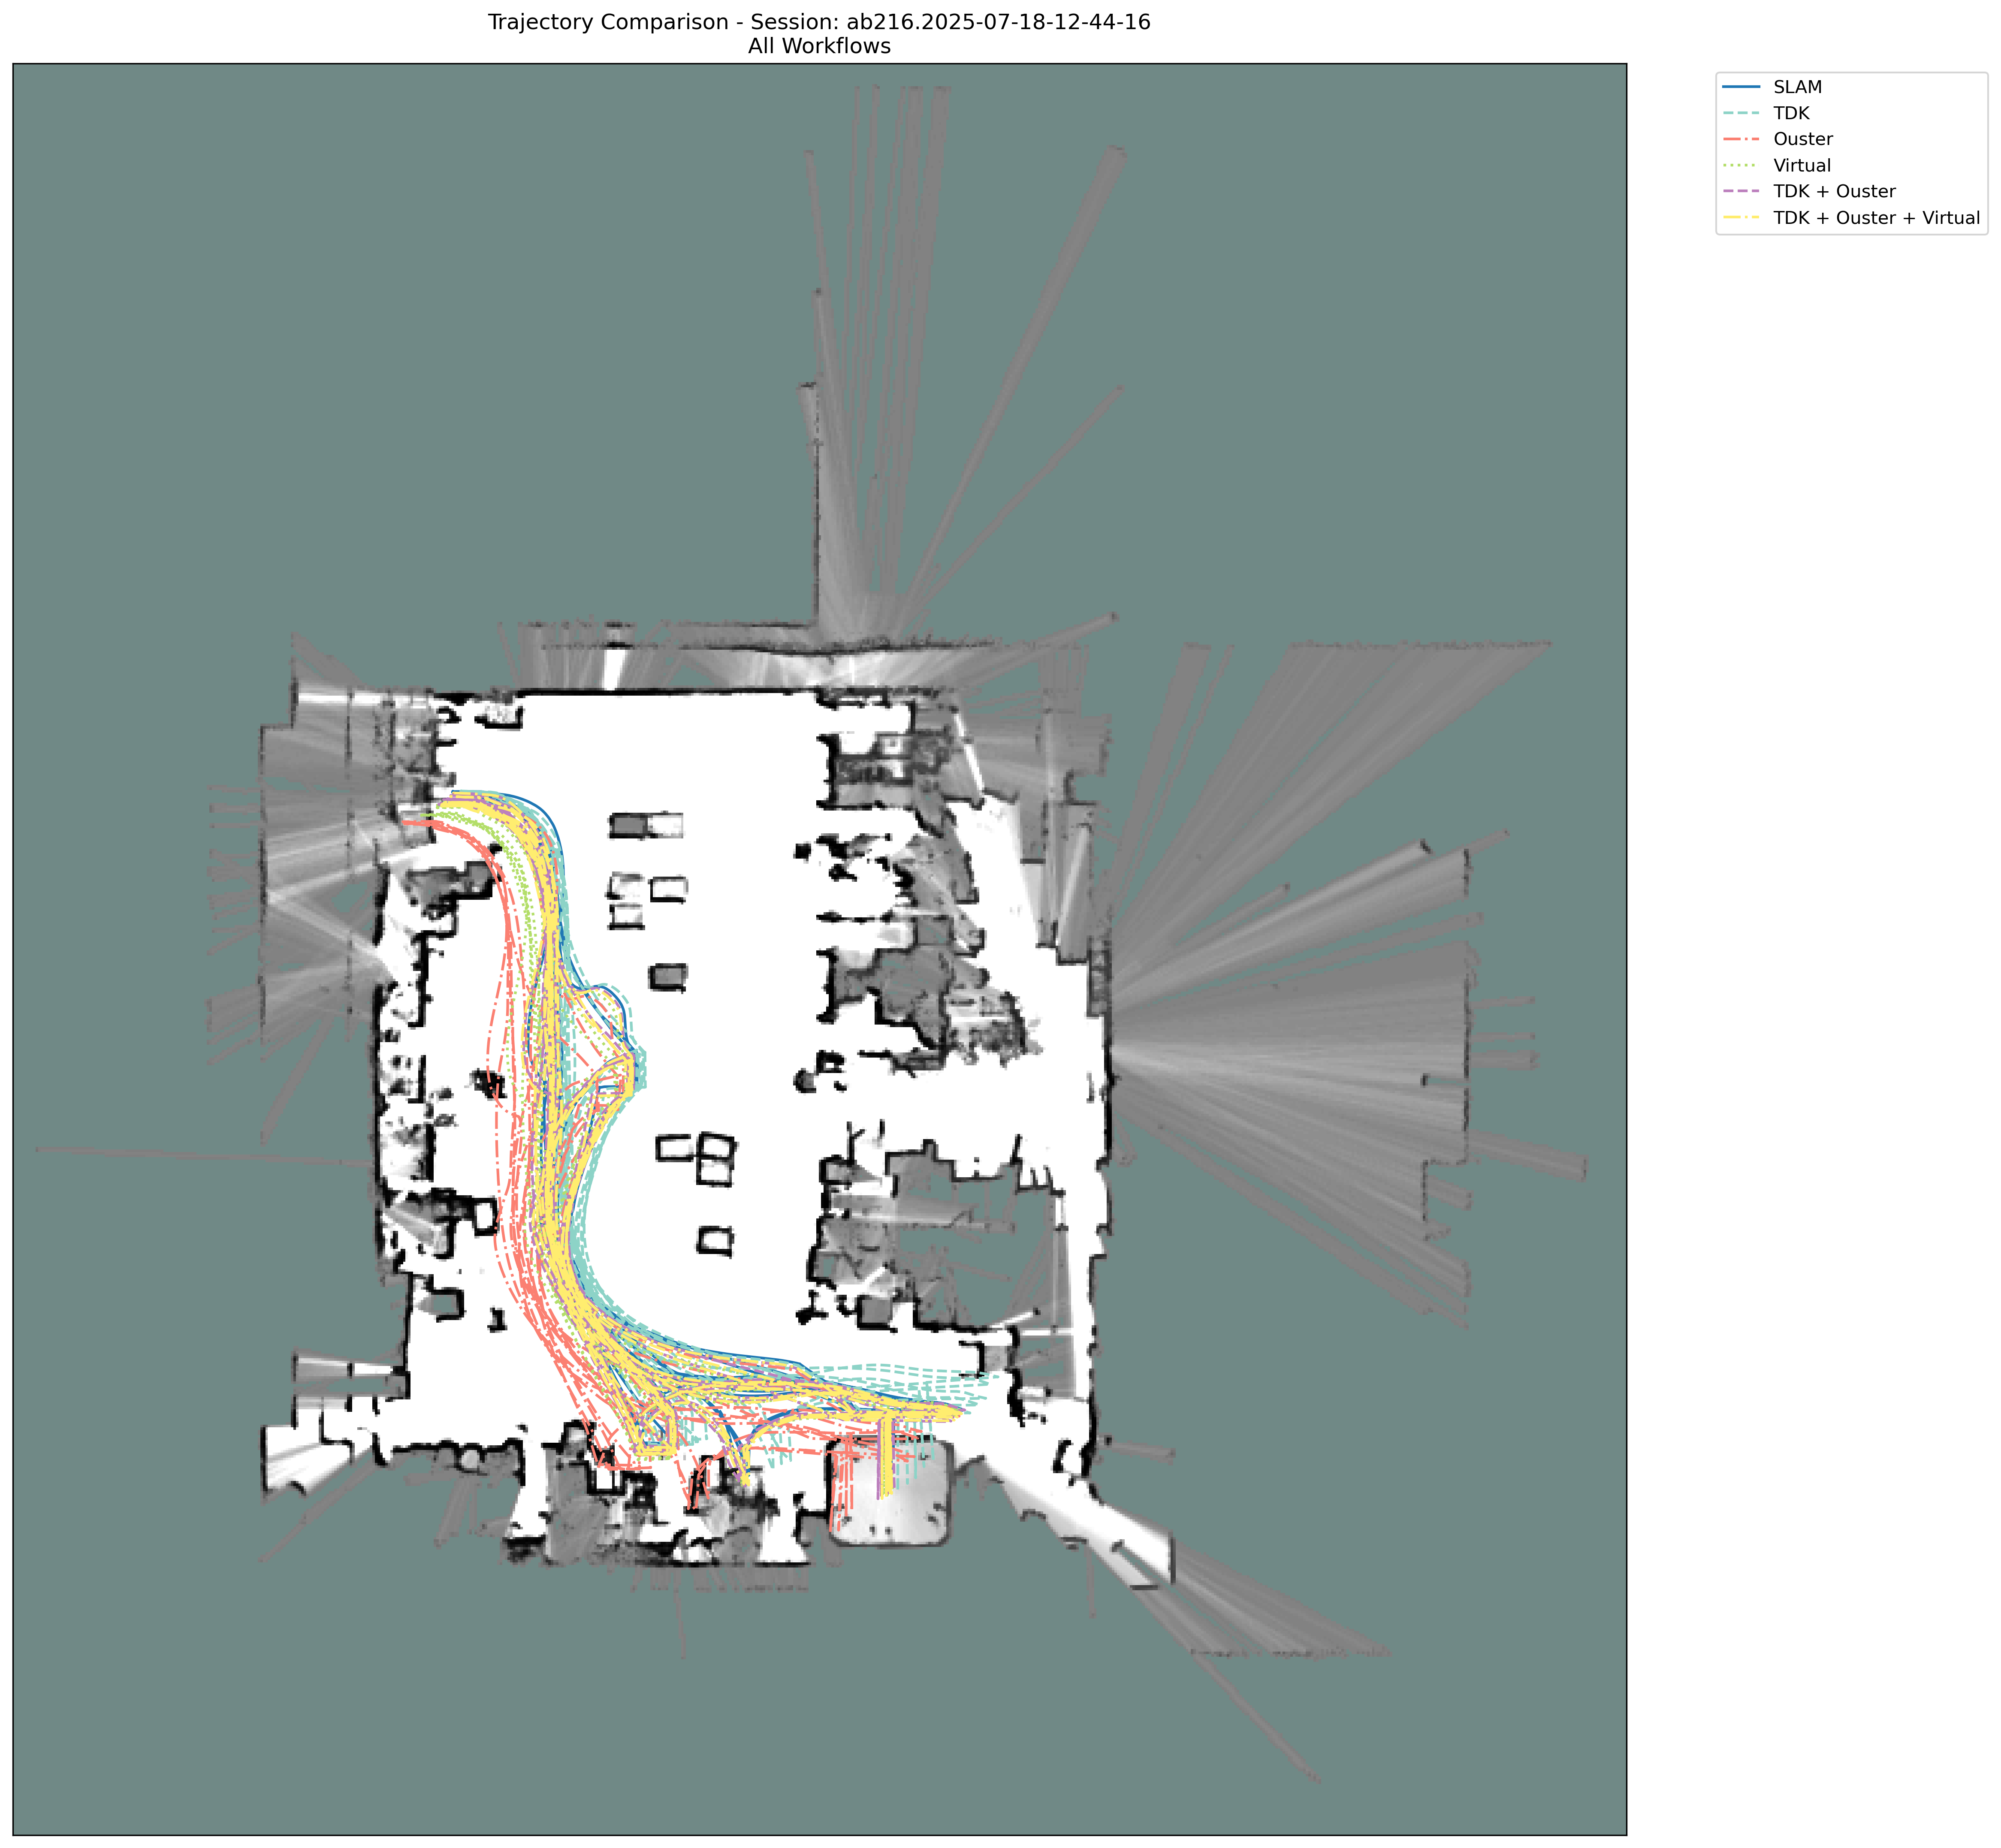
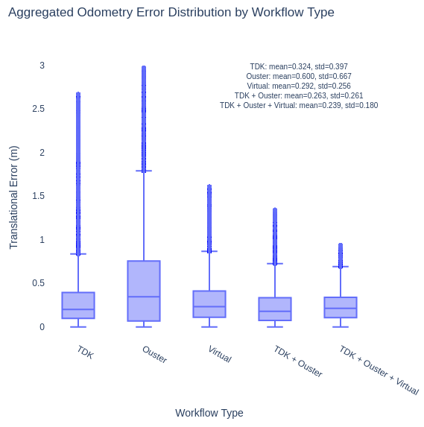
Generating and incorporating a virtual IMU helps!
Translation error in wheel–IMU odometry (/odom_fusion) over nine 1-hour sessions, depending on the IMU(s) used
2025-07-18-15-11-06
2025-07-23-13-59-33
2025-07-18-15-11-06
IMU | Mean (Stdv.)
TDK | 0.324 (0.397)
Ouster | 0.600 (0.667)
Virtual | 0.292 (0.256)
TDK + Ouster | 0.263 (0.261)
TDK + Ouster + Virtual | 0.239 (0.180)
What the existing Gluon codebase does
What this project improves
Code available [GluonImuFusion] [CR]

Slide 3
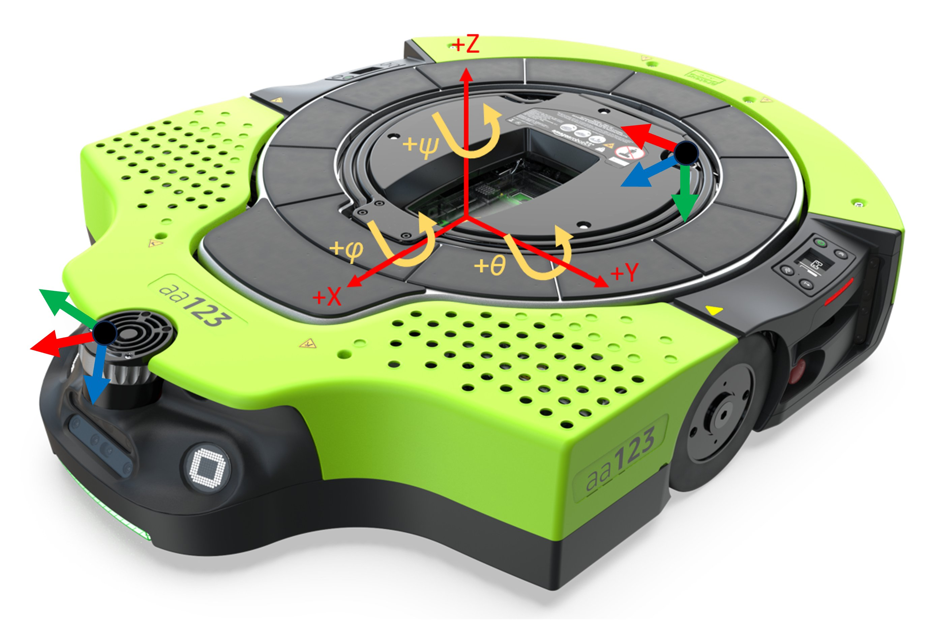
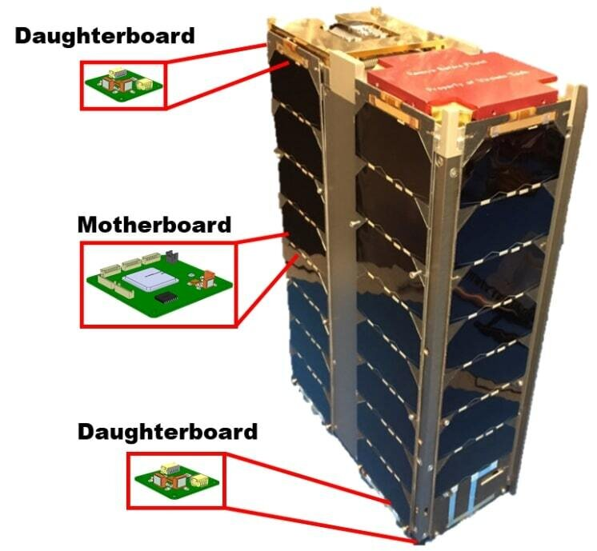
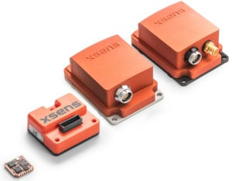
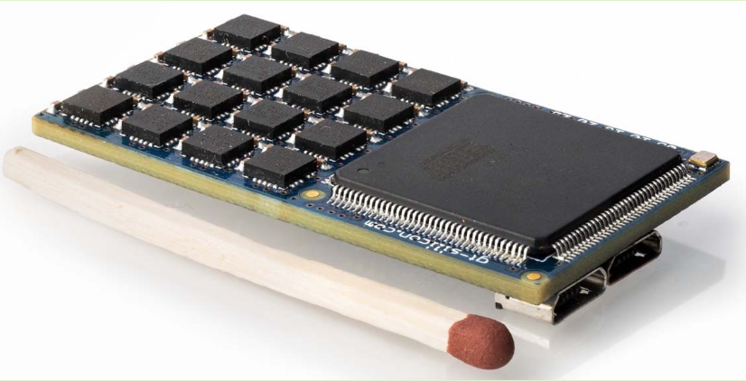
Introduction – IMU is essential in mobile robots
IMU measures specific force (by accelerometer) and angular rate (by gyroscope) along three orthogonal axes
IMU is pivotal component of modern mobile robots – including Proteus with various applications (e.g., navigation, anomaly detection)
Xsens IMUs (single-IMU system)
Array of 32 MPU9150 IMUs (multi-IMU system)
A distributed inertial navigation system on a spacecraft
The coordinate frames of the Ouster IMU (left) and TDK IMU (right) on the drive unit. (Red: x, Green: y, Blue: z)

Slide 4
Motivation – Ensuring accurate IMU measurement is important!
In reality, IMU measurements deviate from their “true values” (i.e., what we are supposed to measure)
What we actually measure
What we are supposed to measure
Spatial and temporal relationships (when multiple IMUs are used)
Gyroscope measurement: $\tilde{ω} ≜M_{ω}{{}_{}^{I}ω}_{WI}+b_{ω}+η_{ω}$
Accelerometer measurement: $\tilde{a} ≜M_{a}\left({{}_{}^{I}a}_{WI}−{}_{}^{I}g\right)+b_{a}+η_{a}$
Quantities subject to be estimated and calibrated
Scale and non-orthogonality matrices
Time-varying biases
White noises
Quantities subject to be mitigated (e.g., by filter or sensor fusion)
${{}_{}^{I}a}_{WI}$: Linear acceleration of the IMU frame with respect to the world fame, expressed in the IMU frame
${{}_{}^{I}ω}_{WI}$: Angular velocity of the IMU frame with respect to the world fame, expressed in the IMU frame
I explored several approaches that would allow us to obtain the “true values”

Slide 5
Overview
Calibration of IMUs
Estimable vs. non-estimable calibration parameters of drive-unit IMUs
Static testing for intrinsic accelerometer calibration
Inter-IMU temporal calibration via time-offset search maximizing gyroscope magnitude correlation
Experiment: Pure IMU odometry before and after calibration
Multi-IMU fusion for noise & drift reduction
Generating a virtual IMU from TDK and Ouster IMU measurements
Allan variance analysis of the virtual IMU: Does fusion always improve noise and random walk characteristics?
Experiment: Pure IMU odometry using TDK, Ouster, and virtual IMUs
Learning-based IMU bias estimation
Modeling bias evolution (e.g., neural ODE approach)
Experiment: Pure IMU odometry with and without bias compensation estimated via neural ODE
Mutiple-IMU experiments for wheel-IMU odometry
Wheel–IMU odometry with individual IMUs (TDK, Ouster, Virtual)
Wheel–IMU odometry with multiple IMUs

Slide 6
Where we are at
Calibration of IMUs
Estimable vs. non-estimable calibration parameters of drive-unit IMUs
Static testing for intrinsic accelerometer calibration
Inter-IMU temporal calibration via time-offset search maximizing gyroscope magnitude correlation
Experiment: Pure IMU odometry before and after calibration
Multi-IMU fusion for noise & drift reduction
Gyroscope measurement: $\tilde{ω} ≜M_{ω}{{}_{}^{I}ω}_{WI}+b_{ω}+η_{ω}$
Learning-based IMU bias estimation
Accelerometer measurement: $\tilde{a} ≜M_{a}\left({{}_{}^{I}a}_{WI}−{}_{}^{I}g\right)+b_{a}+η_{a}$
Spatial and temporal relationships (when using multiple IMUs)
Mutiple-IMU experiments for wheel-IMU odometry

Slide 7
Estimable vs. non-estimable calibration parameters of drive-unit IMUs
The estimable calibration parameters on drive units are identified
depend on the system’s motions, which determine parameter observability [1-4]
Calibration parameters | Can a drive unit (i.e., a wheeled ground robot) collect the required data? | Reference values
Accelerometer intrinsic | O | Identity
Gyroscope intrinsic | X | Identity
Temporal extrinsic | O | Zero
Spatial extrinsic | X | CAD information (i.e., those in /tf_static)
[1] Yang, Geneva, and Huang. “Multi-Visual-Inertial System: Analysis, Calibration and Estimation.” International Journal of Robotics Research, 2024.
[2] Yang, Geneva, Zuo, and Huang. “Online imu intrinsic calibration: Is it necessary?” RSS 2020.
[3] Chen, Li, Li, Zhou, and Yang. “iKalibr: Unified Targetless Spatiotemporal Calibration for Resilient Integrated Inertial Systems.” IEEE Transactions on Robotics, 2025.
[4] Jauffret. “Observability and fisher information matrix in nonlinear regression.” IEEE Trans. Aerosp. Electron. Syst., 2007.
See Multi-IMU Calibration, Fusion, and Bias Estimation for Improved Odometry and IMU calibration — Static test for accelerometer intrinsic parameter estimation

Slide 8
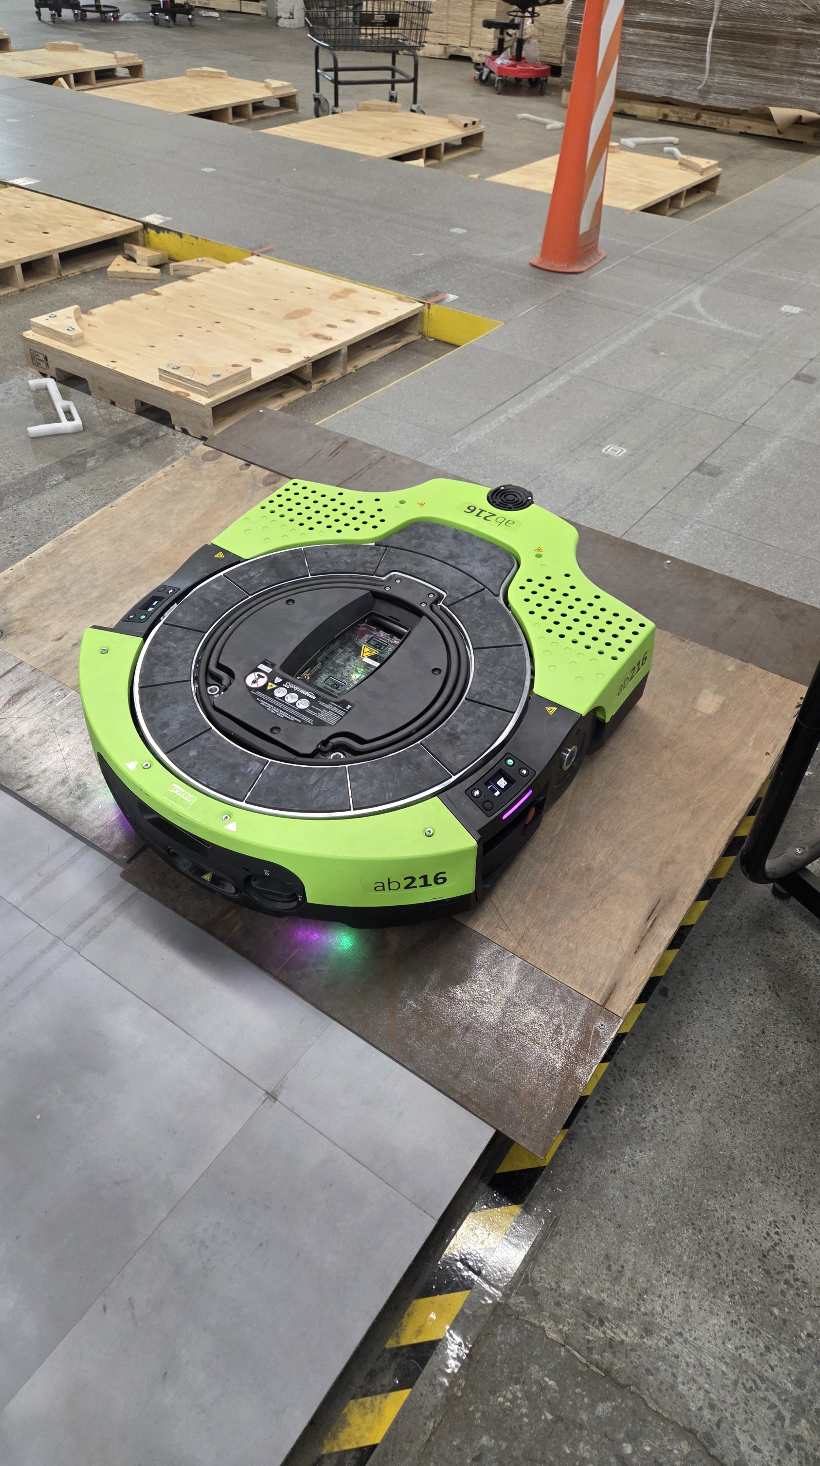
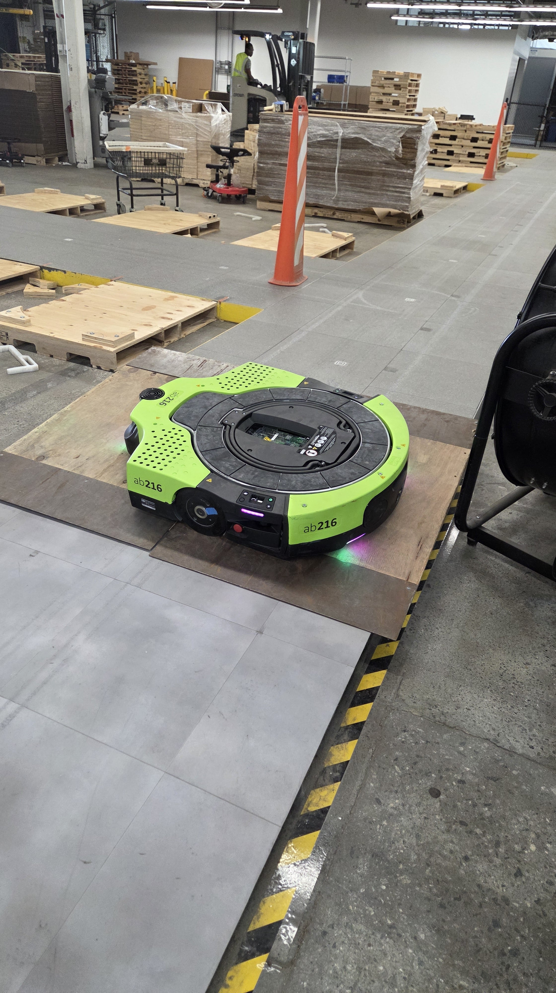
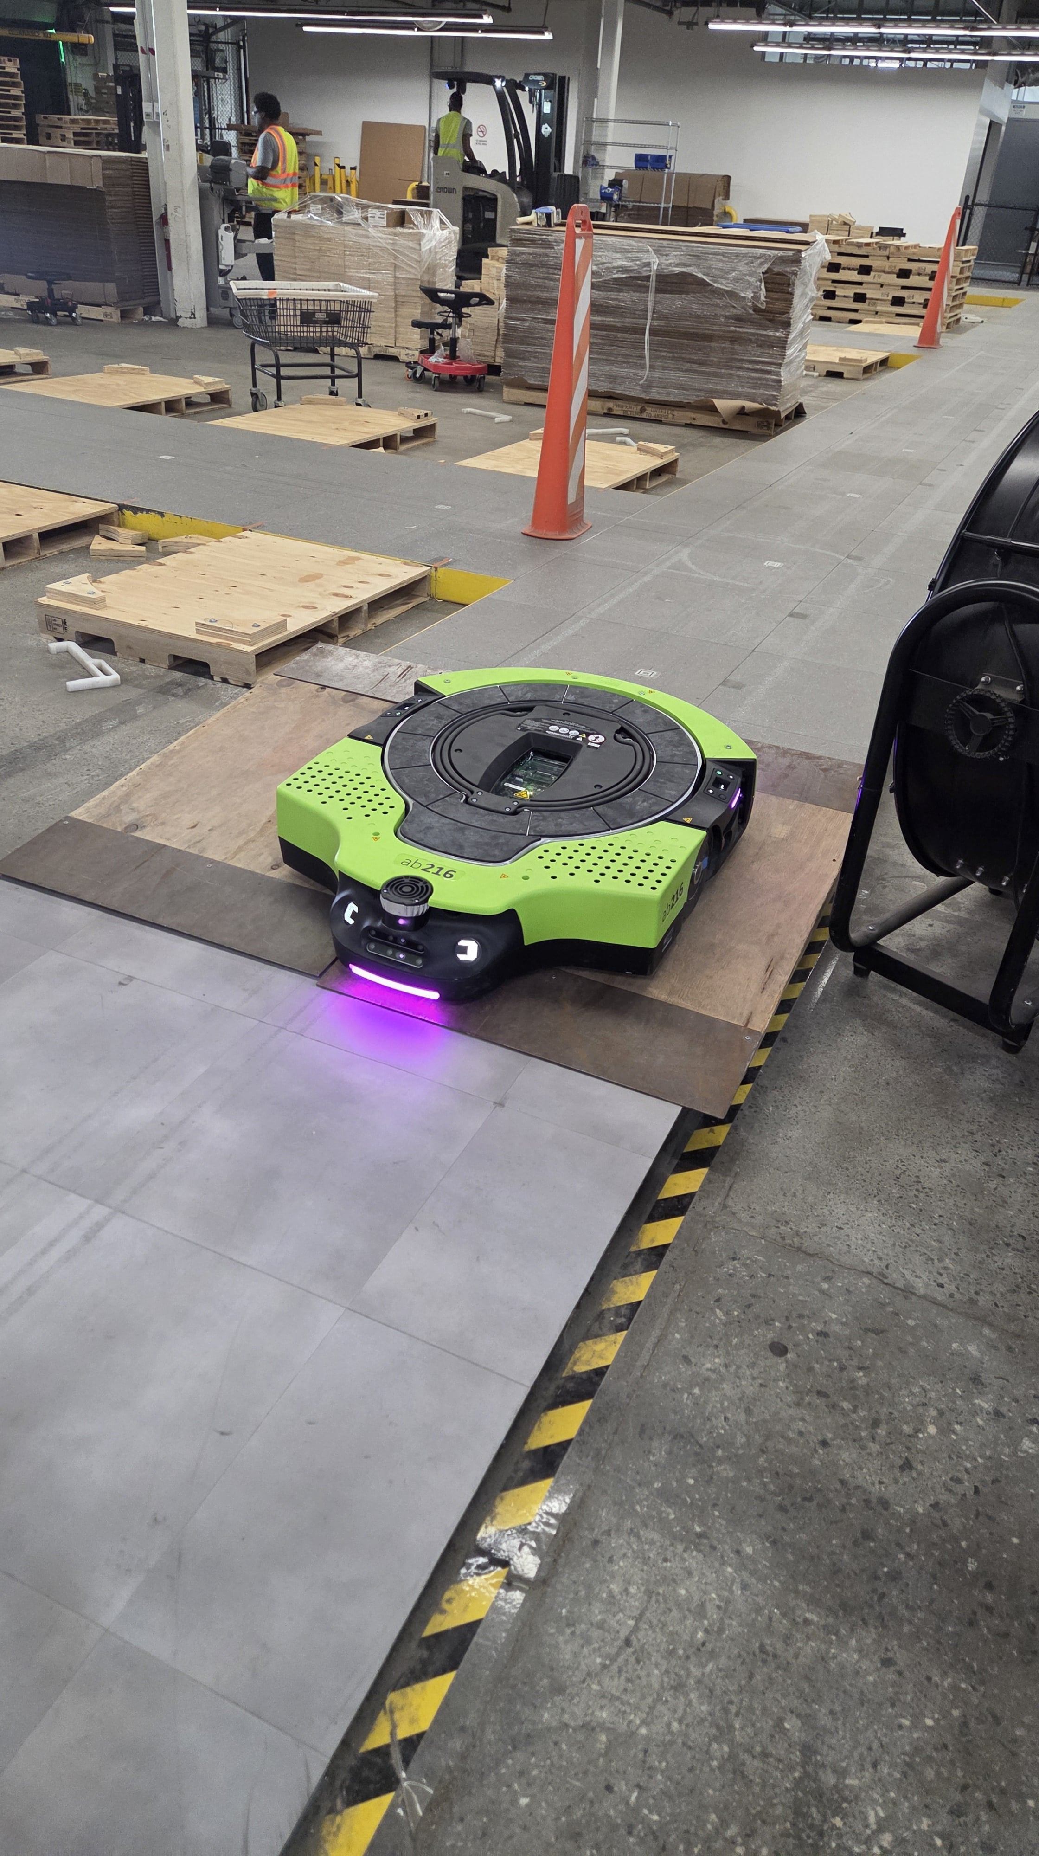
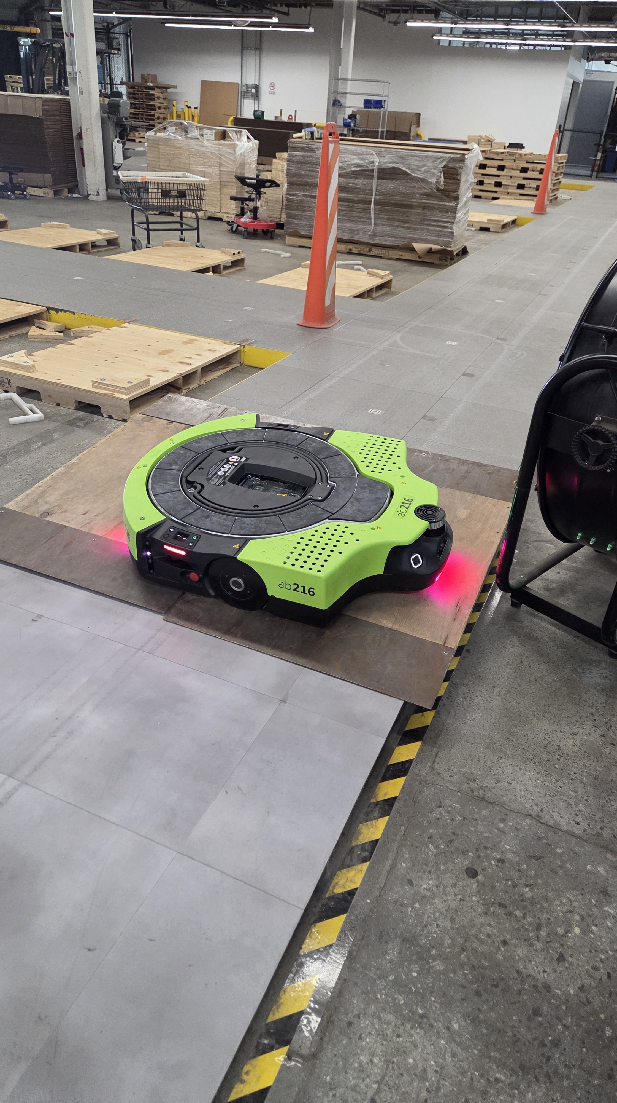
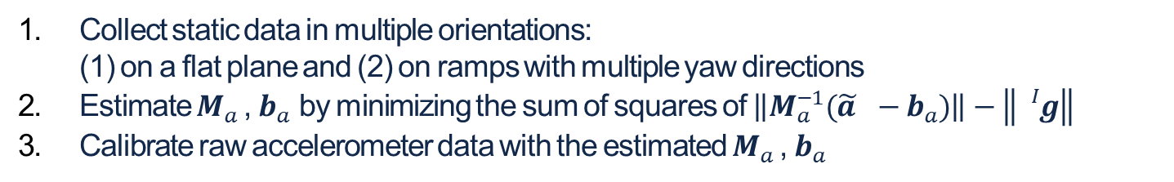
Static testing for intrinsic accelerometer calibration
Accelerometer intrinsics can be estimated from a set of static data by placing the IMU in multiple orientations
The IMU orientations must cover all the three linearly independent orientations
Using a ramp—even at just a few degrees—allows a drive unit to collect data in non-planar orientations
Acquiring static data on a planar surface from the drive unit results in failure!
Collect static data in multiple orientations: (1) on a flat plane and (2) on ramps with multiple yaw directions
Estimate $M_{a}$, $b_{a}$ by minimizing the sum of squares of $\left\|M_{a}^{−1}(\tilde{a } −b_{a})\right\|−\left\|{}_{}^{I}g\right\|$
Calibrate raw accelerometer data with the estimated $M_{a}$, $b_{a}$
+ The constant bias in the gyroscope can also be
estimated and calibrated using static data
See IMU calibration — Static test for accelerometer intrinsic parameter estimation

Slide 9
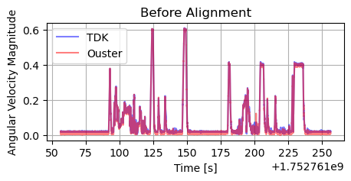
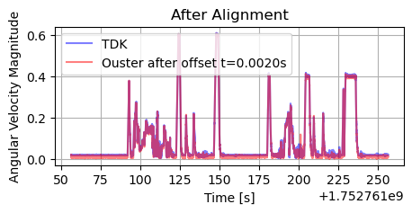
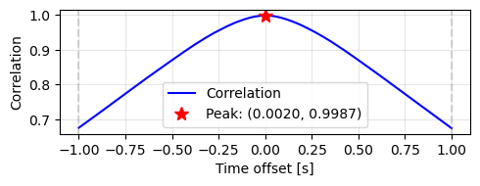
Inter-IMU temporal calibration via time-offset search maximizing gyroscope magnitude correlation
The constant time offset between multiple IMU timestamps can be estimated by maximizing the correlation of gyroscope magnitudes
This is because any location on the same rigid body experiences the same angular velocity magnitudes
+ Ground-truth to the IMU can also
be synced in the same way
See Interim check-in: Multi-IMU fusion for noise reduction

Slide 10

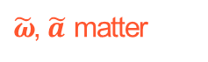
Experiment: Pure IMU odometry before and after calibration
Pure IMU odometry was performed before and after calibration of the IMUs on ab216
$\tilde{ω}$ matters
$\tilde{ω}$, $\tilde{a }$ matter
Mean and standard deviation of absolute orientation error (AOE, °) across 15 sequences
Mean and standard deviation of absolute position error (APE, m) across 15 sequences
 | Uncalibrated | Calibrated
TDK | 68.7 (16.5) | 11.1 (7.3)
Ouster | 39.1 (9.6) | 4.9 (3.1)
 | Uncalibrated | Calibrated
TDK | 253,653.5 (192,948.0) | 12,026.8 (6,156.1)
Ouster | 162,048.0 (124,955.8) | 6,327.2 (6,387.6)
* Aggregated results from 15 sequences across four sessions, with durations of 4-10 min, trajectory lengths of 230-1050 m, and rotations of 1100-3000°
Calibration helps!
Any results, in what follows, were obtained using calibrated data (unless otherwise specified)

Slide 11
Where we are at
Calibration of IMUs
Multi-IMU fusion for noise & drift reduction
Generating a virtual IMU from TDK and Ouster IMU measurements
Allan variance analysis of the virtual IMU: Does fusion always improve noise and random walk characteristics?
Experiment: Pure IMU odometry using TDK, Ouster, and virtual IMUs
Learning-based IMU bias estimation
Gyroscope measurement: $\tilde{ω} ≜M_{ω}{{}_{}^{I}ω}_{WI}+b_{ω}+η_{ω}$
Accelerometer measurement: $\tilde{a} ≜M_{a}\left({{}_{}^{I}a}_{WI}−{}_{}^{I}g\right)+b_{a}+η_{a}$
Mutiple-IMU experiments for wheel-IMU odometry

Slide 12
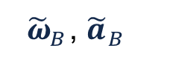
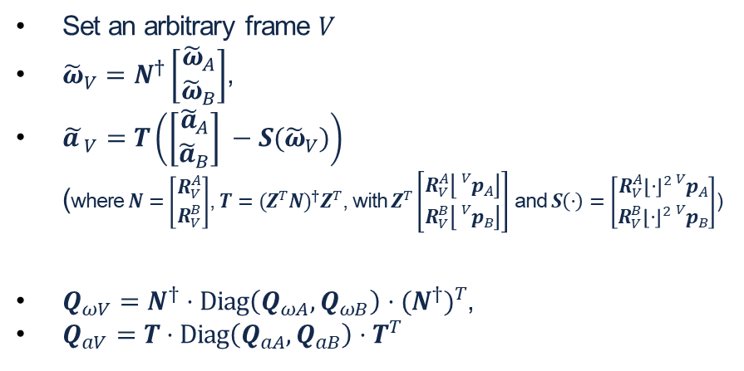

where $R_{V}^{A}∈SO(3)$, ${}_{}^{V}{p_{A}}∈ℝ^{3}$
Generating a virtual IMU from TDK and Ouster IMU measurements
The measurement of a virtual IMU is generated by combining data from the TDK and Ouster IMUs
In what follows, let it be identical to the TDK frame $A$
TDK
Set an arbitrary frame $V$
${\tilde{ω}}_{V}=N^{†}\left[\begin{matrix}{\tilde{ω}}_{A} \\ {\tilde{ω}}_{B}\end{matrix}\right]$,
${\tilde{a }}_{V}=T\left(\left[\begin{matrix}{\tilde{a}}_{A} \\ {\tilde{a}}_{B}\end{matrix}\right] −S({\tilde{ω}}_{V})\right)$ (where $N=\left[\begin{matrix}R_{V}^{A} \\ R_{V}^{B}\end{matrix}\right]$, $T={(Z^{T}N)}^{†}Z^{T}$, with $Z^{T}\left[\begin{matrix}R_{V}^{A}\left\lfloor {}_{}^{V}{p_{A}}\right\rfloor \\ R_{V}^{B}\left\lfloor {}_{}^{V}{p_{B}}\right\rfloor \end{matrix}\right]$ and $S\left(⋅\right)=\left[\begin{matrix}R_{V}^{A}{\left\lfloor ⋅\right\rfloor }^{2}{}_{}^{V}{p_{A}} \\ R_{V}^{B}{\left\lfloor ⋅\right\rfloor }^{2}{}_{}^{V}{p_{B}}\end{matrix}\right]$)
$Q_{ωV}=N^{†}⋅Diag\left(Q_{ωA},Q_{ωB}\right)⋅{(N^{†})}^{T}$,
$Q_{aV}=T⋅Diag\left(Q_{aA},Q_{aB}\right)⋅T^{T}$
${\tilde{ω}}_{A}$, ${\tilde{a }}_{A}$
Ouster
${\tilde{ω}}_{B}$, ${\tilde{a }}_{B}$
Caveat 1: If two identical IMUs are combined, the noise is reduced by √2 Caveat 2: If two IMUs are of the same grade (i.e., difference < √3), the noise is reduced compared to using a single IMU alone
The coordinate frames of the Ouster IMU (left) and TDK IMU (right) on the drive unit. (Red: x, Green: y, Blue: z)
[6] Zhang, Xu, Chen, and Li. “A Lightweight and Accurate Localization Algorithm Using Multiple Inertial Measurement Units.” IEEE Robotics and Automation Letters, 2020.

Slide 13
Allan variance analysis of the virtual IMU: Does fusion always improve noise and random walk characteristics?
We assess the white noise and random walk characteristics of TDK, Ouster, and virtual IMUs
Allan variance analysis of white noise and random walk characteristics for TDK, Ouster, and virtual IMUs on ab216
 | TDK | Ouster | Virtual
White noise in gyroscope (Unit: rad/s/√Hz) | 9.22E-05 | 3.38E-04 | 1.84E-04
White noise in accelerometer (Unit: m/s²/√Hz) | 1.59E-03 | 6.47E-03 | 2.01E-03
Random walk in gyroscope (Unit: rad/s·√Hz) | 4.73E-06 | 2.04E-06 | 4.93E-07
Random walk in accelerometer (Unit: m/s²·√Hz) | 0.00E+00 | 0.00E+00 | 0.00E+00
A virtual IMU may not necessarily outperform the TDK and Ouster IMUs in both white noise and random walk characteristics
[8] Cho and Park, “A calibration technique for a redundant imu containing low-grade inertial sensors.” ETRI journal, 2005.
Code available [GluonImuNavTools] [CR]

Slide 14

Experiment: Pure IMU odometry using TDK, Ouster, and virtual IMUs
Pure IMU odometry was performed on the TDK, Ouster, and virtual IMUs on ab216
$\tilde{ω}$ matters
$\tilde{ω}$, $\tilde{a }$ matter
Mean and standard deviation of absolute orientation error (AOE, °) across 15 sequences
Mean and standard deviation of absolute position error (APE, m) across 15 sequences
TDK | Ouster | Virtual
11.1 (7.3) | 4.9 (3.1) | 7.2 (4.9)
TDK | Ouster | Virtual
12,026.8 (6,156.1) | 6,327.2 (6,387.6) | 6,497.9 (3,465.0)
* Aggregated results from 15 sequences across four sessions, with durations of 4-10 min, trajectory lengths of 230-1050 m, and rotations of 1100-3000°
The largest error in the TDK IMU is likely due to its higher random walk compared to the Ouster or virtual IMUs
The impact of introducing virtual IMU for wheel-IMU odometry on drive units will be discussed later

Slide 15
Where we are at
Calibration of IMUs
Multi-IMU fusion for noise & drift reduction
Learning-based IMU bias estimation
Modeling bias evolution (e.g., neural ODE approach)
Experiment: Pure IMU odometry with and without bias compensation estimated via neural ODE
Mutiple-IMU experiments for wheel-IMU odometry
Gyroscope measurement: $\tilde{ω} ≜M_{ω}{{}_{}^{I}ω}_{WI}+b_{ω}+η_{ω}$
Accelerometer measurement: $\tilde{a} ≜M_{a}\left({{}_{}^{I}a}_{WI}−{}_{}^{I}g\right)+b_{a}+η_{a}$

Slide 16



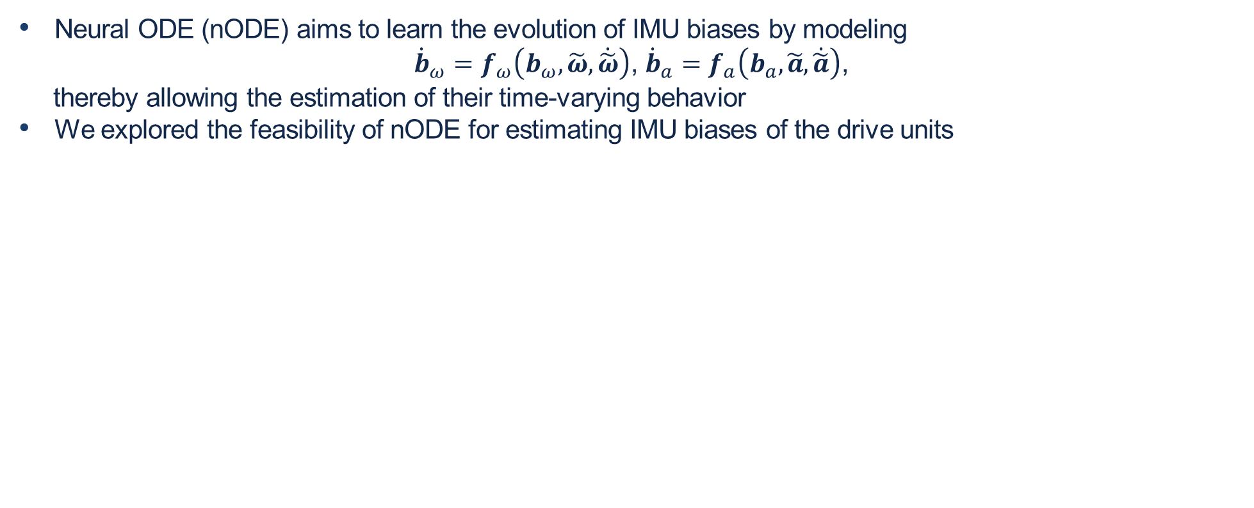








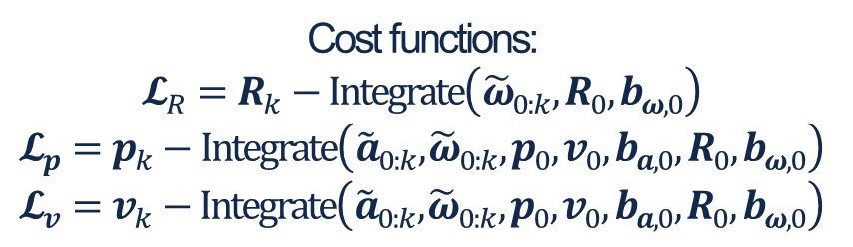

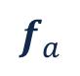



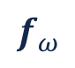



Modeling bias evolution (e.g., neural ODE approach)
Neural ODE (nODE) aims to learn the evolution of IMU biases by modeling
${\dot{b}}_{ω}=f_{ω}\left(b_{ω}, \tilde{ω},\dot{\tilde{ω}}\right)$, ${\dot{b}}_{a}=f_{a}\left(b_{a}, \tilde{a},\dot{\tilde{a}}\right)$,
thereby allowing the estimation of their time-varying behavior
We explored the feasibility of nODE for estimating IMU biases of the drive units
$$f_{ω}$$
$$f_{a}$$
Cost functions: $$𝓛_{R}=R_{k}−Integrate\left({\tilde{ω}}_{0:k}, R_{0},b_{ω, 0}\right)$$
$$𝓛_{p}=p_{k}−Integrate\left({\tilde{a}}_{0:k},{\tilde{ω}}_{0:k},p_{0},v_{0},b_{a, 0},R_{0},b_{ω, 0}\right)$$
$$𝓛_{v}=v_{k}−Integrate\left({\tilde{a}}_{0:k},{\tilde{ω}}_{0:k},p_{0},v_{0},b_{a, 0},R_{0},b_{ω, 0}\right)$$
$$b_{ω}$$
$$b_{a}$$
$$⋮$$
$$⋮$$
$$⋮$$
$$⋮$$
$$⋮$$
$$⋮$$
$$\tilde{ω}$$
$${\dot{b}}_{ω}$$
$$\tilde{a }$$
$${\dot{b}}_{a}$$
$$\dot{\tilde{ω}}$$
$$⋮$$
$$⋮$$
$$⋮$$
$$\dot{\tilde{a }}$$
$$⋮$$
$$⋮$$
$$⋮$$
9 layers, 28K parameters
11 layers, 210K parameters
[7] Liu, Lin, Zhang, and Ghaffari. “Debiasing 6-DOF IMU via Hierarchical Learning of Continuous Bias Dynamics.” RSS 2025.

Slide 17


Experiment: Pure IMU odometry with and without bias compensation estimated via neural ODE
Pure IMU odometry was conducted on the TDK, Ouster, and virtual IMUs for ab216, (1) without and (2) with compensating the time-varying bias estimated by nODE
$\tilde{ω}$ matters
$\tilde{ω}$, $\tilde{a }$ matter
Mean and standard deviation of absolute orientation error (AOE, °) across 15 sequences
Mean and standard deviation of absolute position error (APE, m) across 15 sequences
 | Without nODE | With nODE
TDK | 11.1 (7.3) | 27.7 (14.8)
Ouster | 4.9 (3.1) | 54.6 (36.8)
Virtual | 7.2 (4.9) | 38.6 (17.3)
 | Without nODE | With nODE
TDK | 12,026.8 (6,156.1) | 22,734.0 (33,131.8)
Ouster | 6,327.2 (6,387.6) | 123,810.1 (151,618.9)
Virtual | 6,497.9 (3,465.0) | 10,157.8 (15,289.8)
* Aggregated results from 15 sequences across four sessions, with durations of 4-10 min, trajectory lengths of 230-1050 m, and rotations of 1100-3000° ** Training data from 30 sequences from the same four sessions, with no overlap with sequences for evaluation
nODE does not reduce errors in IMU odometry for the drive units, leaving room for future work

Slide 18
Where we are at
Calibration of IMUs
Multi-IMU fusion for noise & drift reduction
Learning-based IMU bias estimation
When integrated into Gluon codebase
Mutiple-IMU experiments for wheel-IMU odometry
Wheel–IMU odometry with individual IMUs (TDK, Ouster, Virtual)
Wheel–IMU odometry with multiple IMUs

Slide 19
Wheel–IMU odometry with individual IMUs (TDK, Ouster, Virtual)
Translation error in wheel–IMU odometry (/odom_fusion) over nine 1-hour sessions, depending on the IMU(s) used
2025-07-18-15-11-06
2025-07-23-13-59-33
IMU | Mean (Stdv.)
TDK | 0.324 (0.397)
Ouster | 0.600 (0.667)
Virtual | 0.292 (0.256)
TDK + Ouster | 0.263 (0.261)
TDK + Ouster + Virtual | 0.239 (0.180)
Using a virtual IMU for wheel-IMU odometry yields lower errors than using either the TDK or Ouster IMU individually

Slide 20
Wheel–IMU odometry with multiple IMUs
Translation error in wheel–IMU odometry (/odom_fusion) over nine 1-hour sessions, depending on the IMU(s) used
2025-07-18-15-11-06
2025-07-23-13-59-33
IMU | Mean (Stdv.)
TDK | 0.324 (0.397)
Ouster | 0.600 (0.667)
Virtual | 0.292 (0.256)
TDK + Ouster | 0.263 (0.261)
TDK + Ouster + Virtual | 0.239 (0.180)
Using multiple IMUs for wheel-IMU odometry yields lower errors than using a single IMU
TDK+Ouster+virtual yields lower errors than TDK+Ouster
What existing Gluon codebase does

Slide 21
Summary
In General (Theory, Literature, etc.) | For Drive Units
Calibration is beneficial | Calibration is beneficial
Combining multiple IMUs of a similar grade can reduce noise | Combining the TDK and Ouster IMUs may not reduce all white noise and random walk characteristics; however, using a virtual IMU improves wheel-IMU odometry when tested over multiple sessions on a drive unit
Neural ODE can estimate biases well on open-source datasets | Neural ODE does not estimate biases well on the drive unit; this requires further work

Slide 22
Thank You!

